Slide 1

Photonic Reagents for Probing and Controlling Biological Systems
Denys Bondar and Alexey Goun, Princeton University
Bits
Biology
Princeton University
Herschel Rabitz, PI
Alexei Goun
Ali Er
Denys Bondar
Anna Paulson

Slide 2
Photonic reagents: Introducion
Photonic reagents is chemistry with light
or
Photonic reagents are smart laser pulses shaped to induce a desired dynamics in a molecular system
Applications of Photonic reagents
Discrimination of large number of FPs
Controlling optogenetic switches
Underlying difficulties: Overlapping spectra
Bits
Biology
Bits
Biology

Slide 3
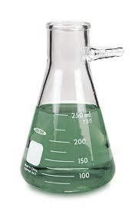
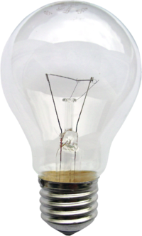
Photonic reagents: Probing (FPs)
Emission spectra
Samples
Light sources
Incoherent light
or CW laser
Photonic
reagent 1
Photonic
reagent 2

Slide 4
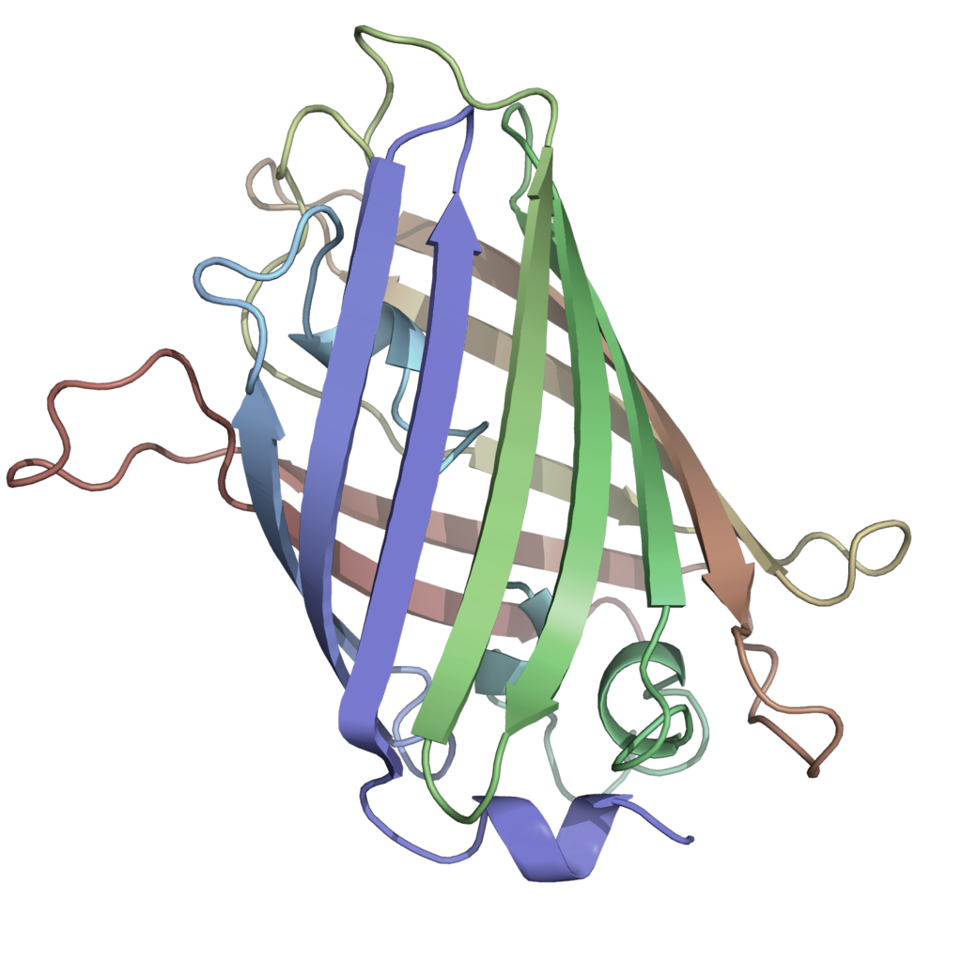
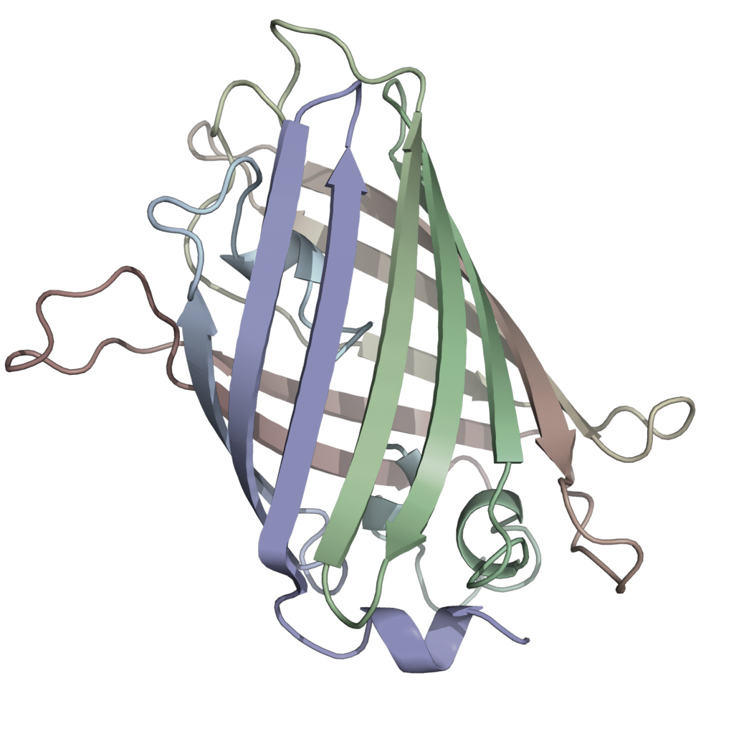
Photonic reagents: Probing (FPs)
Excited electronic state
Energy
Vibrational relaxation
Photonic
reagent
Fluorescence
Ground electronic state

Slide 5
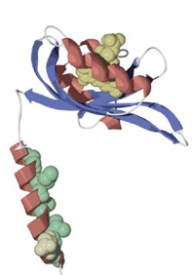
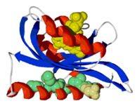
Photonic reagents: Control (Optogenetics)
On state
Photonic reagents
Off state

Slide 6
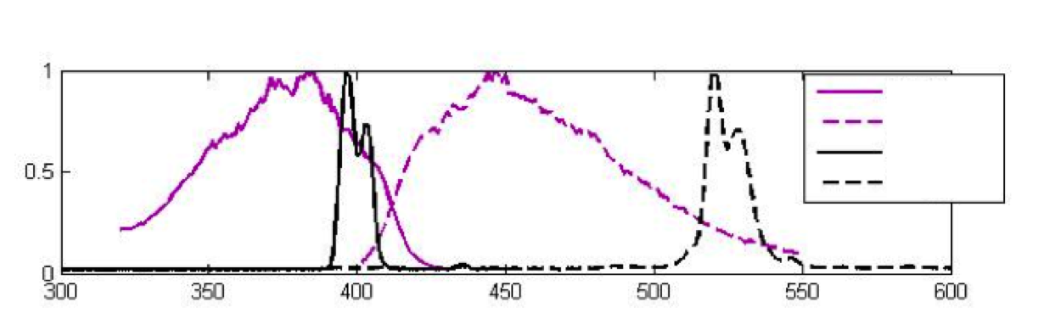
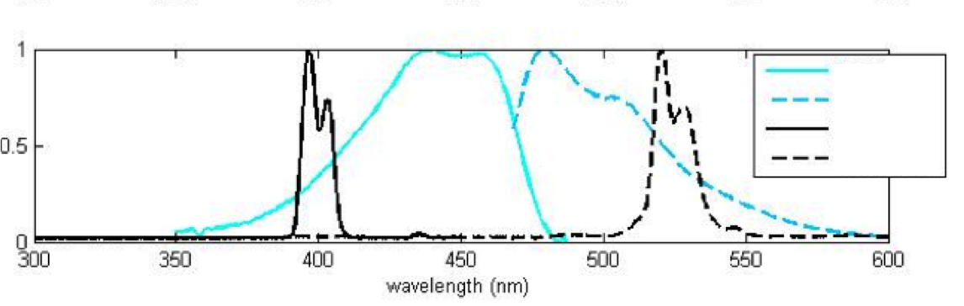
ECFP / EBFP concentration determination
EBFP ex
EBFP em
pump pulse
dump pulse
Excitation by
pump pulse
Stimulated emission by
dump pulse
ECFP ex
ECFP em
pump pulse
dump pulse
Notes:
solid Magenta lines

Slide 7
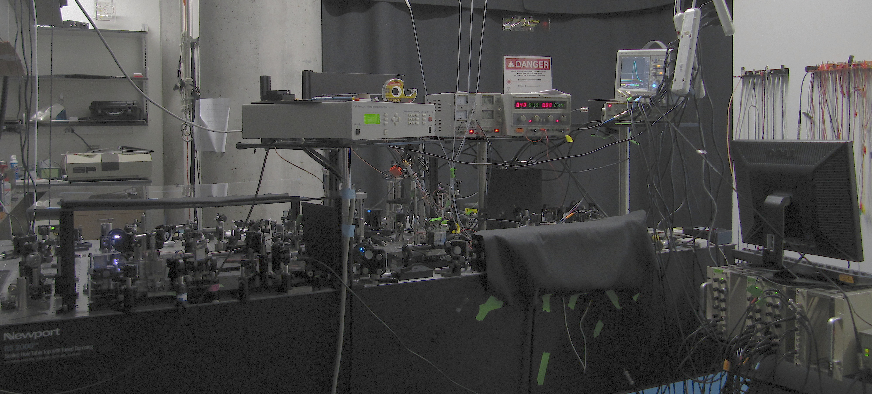
Closed Loop Optimization Experiment Photos

Slide 8
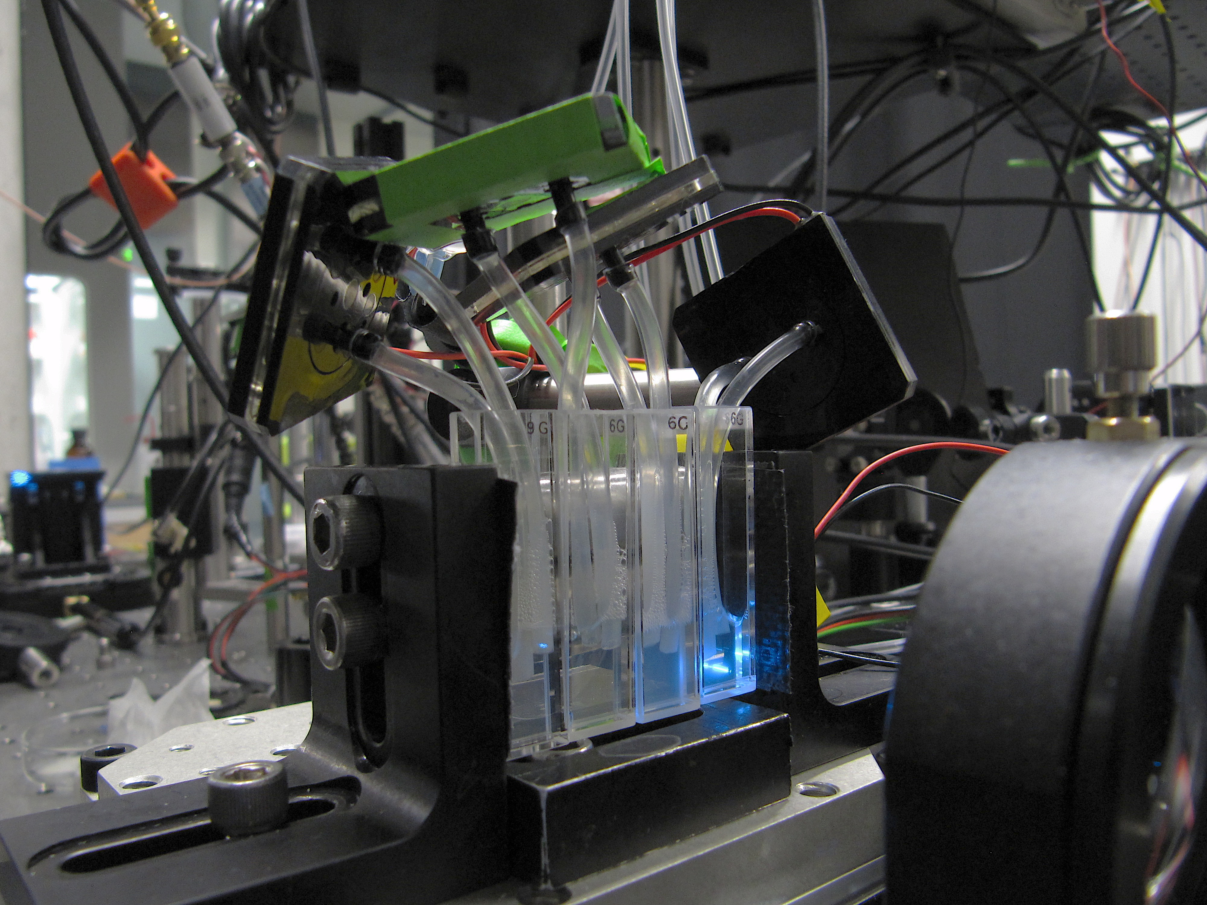
Closed Loop Optimization Experiment Photos

Slide 9
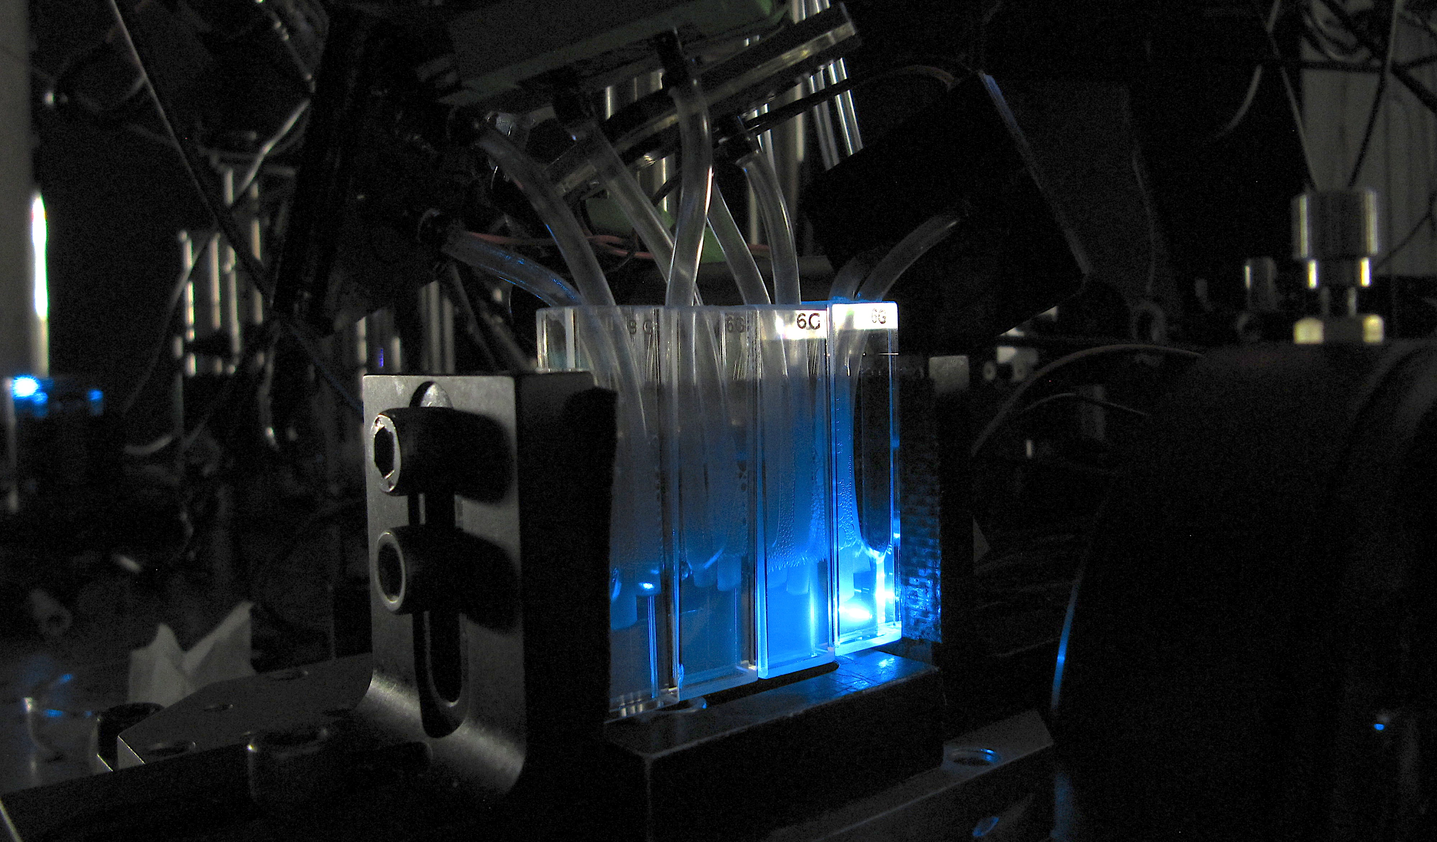
Closed Loop Optimization Experiment Photos

Slide 10
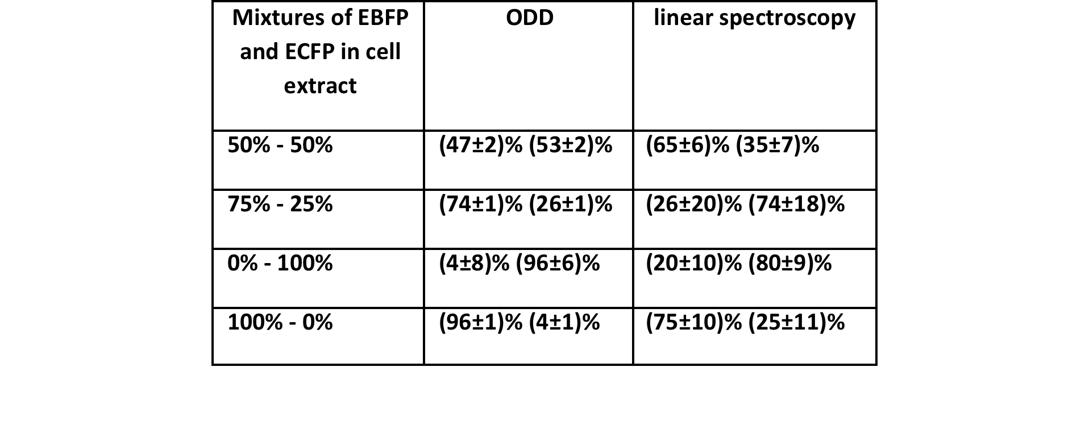
ECFP / EBFP concentration determination
in cell extract
Probability of false positive detection: ODD 15% Linear spec. 90%
FP absolute concentrations used: (2.4-0.8) μM
ODD outperforms linear spectroscopy

Slide 11
Results
30% depletion in ECFP and EBFP
10 fold increased in accuracy of concentration determination
6 fold decrease of false positive probability

Slide 12
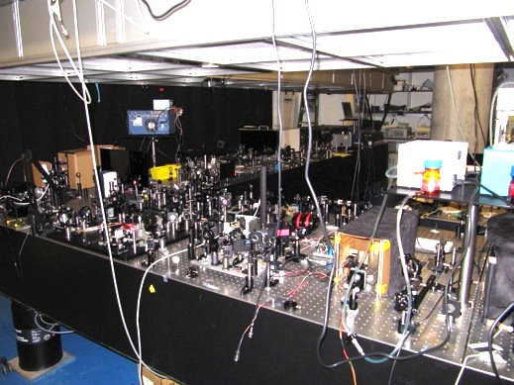
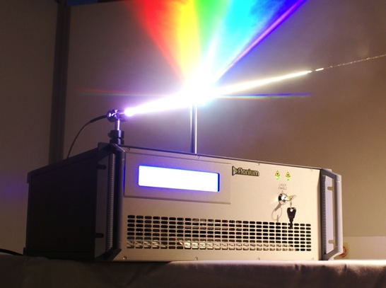
Next Steps
What’s missing?
Compact broad bandwidth shaped source to enable technology transfer
Ultimate impact of this technology
  Significantly discriminate amongst large numbers of molecules
  Selective activation of optical switches
Now
Near Future

Slide 13
Broad bandwidth optical source with multiple fluorescent proteins
Complete coverage of the electronic degrees of freedom.

Slide 14
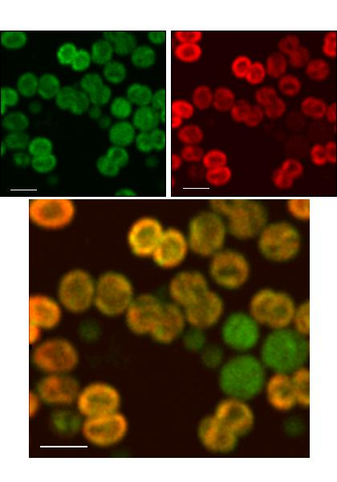
Spectrally resolved imaging.
Hyperspectral imaging by utilizing excessive pixel density of camera system.

Slide 15
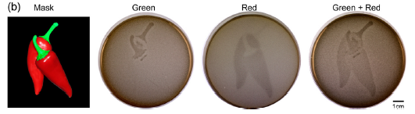
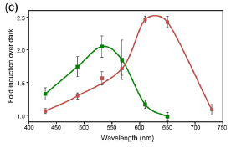
Multiplexing of optogenetic components
Spectral overlap prevents full access to control space of optogenetic components.

Slide 16
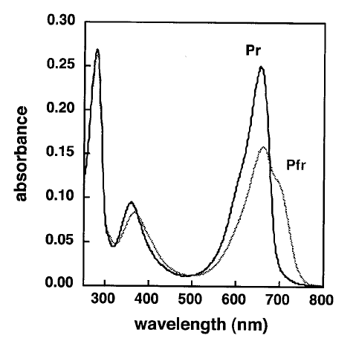
Multiplexing of optogenetic components
Full dynamic range of single optogenetic switch, complete spectral coverage electronic degrees of freedom of ON/OFF states.

Slide 17

Thank you!
Collaborators:
Herschel Rabitz, PI
Ali Er
Anna Paulson
Jeff Taybor

