Slide 1
Welcome to switi sranan
Fab Lab Suriname; update 2012
Presentation at Fab8; Wellington, New Zealand, 2012
Pieter van der Hijden MSc, Sofos Consultancy
Movie Destination Suriname: http://www.youtube.com/watch?v=ZdZU4WgHgiY

Slide 2
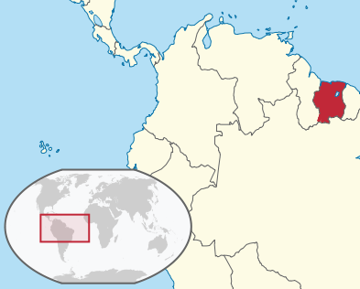
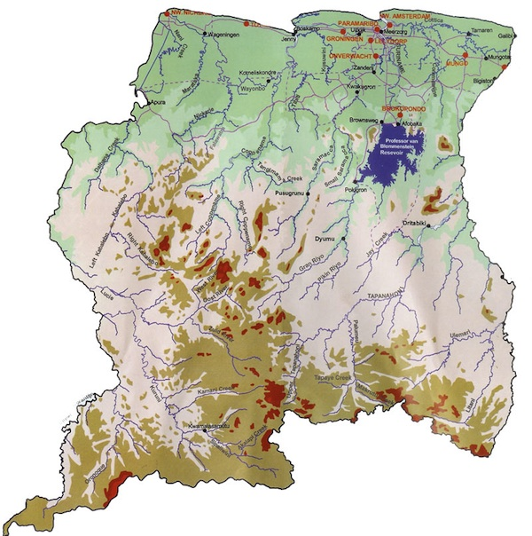
Welcome to suriname
Tropical country
400 * 400 km
Flat coastal strip 80 km
Hilly tropical rainforest with some mountains
Rich of natural resources
Source: www.gov.sr

Slide 3
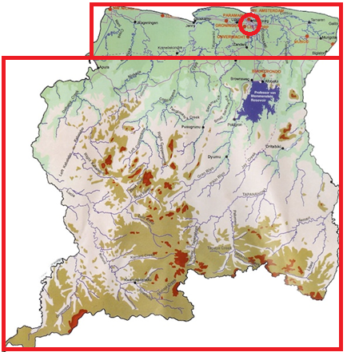
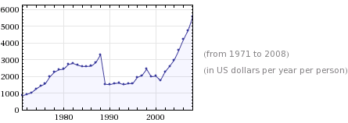
Welcome to suriname
Economy
Mining (oil, gold, bauxite)
Agriculture
Tourism
Offshore (call centres)
GDP pc – Computed by Wolfram Alpha = USD 15.3 per day per person
Population: 80% - urban, 10% - rural, 10% - forest, 500,000 in total

Slide 4
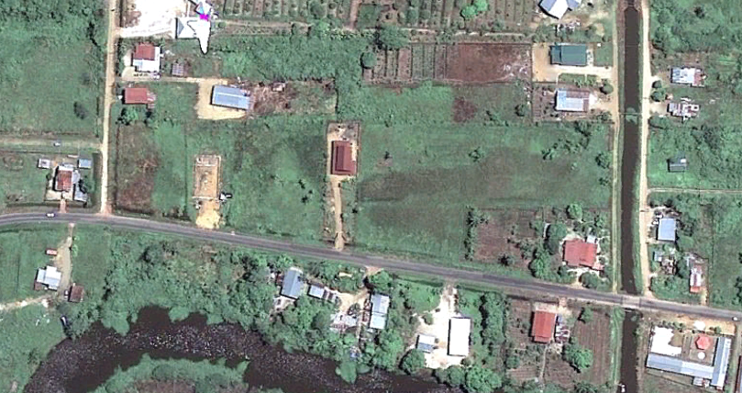
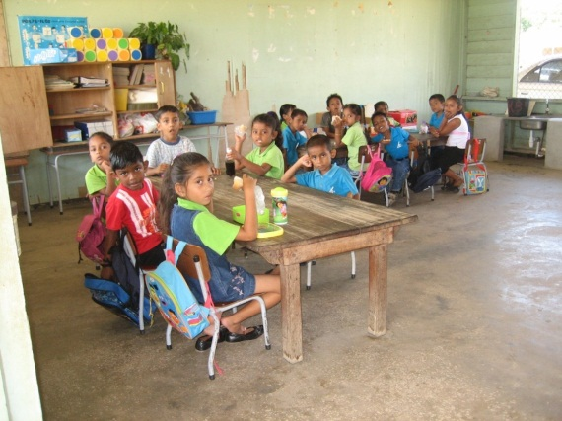
Rural area
close to city - road traffic - schools simple - money economy – modest education – modest income – quiet - static
Source: left: Google Earth

Slide 5
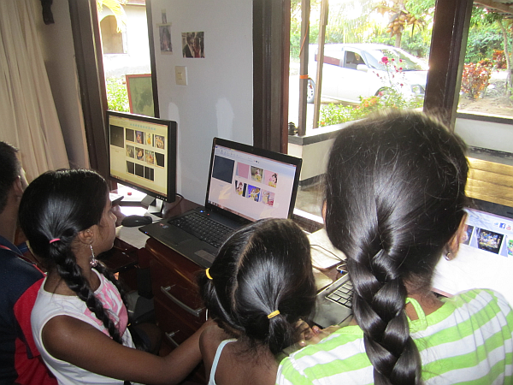
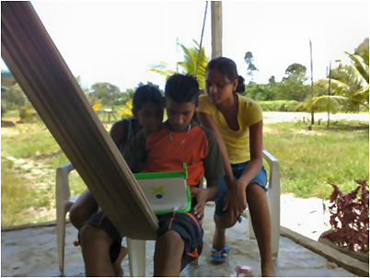
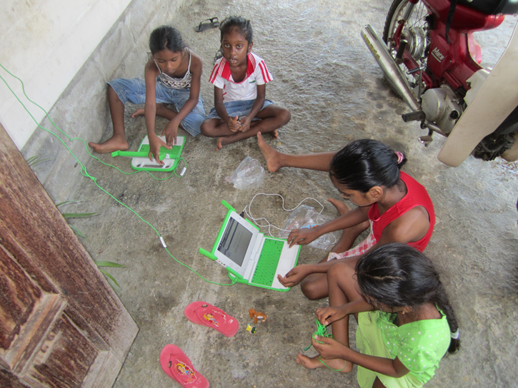
Mini fab lab
OLPC – One Laptop Per Child - Computer Club (Movie Maker, Game Maker, Internet / Wifi) - Cameo Cutting Device - Arduino, Raspberry Pi - informal learning - social development

Slide 6
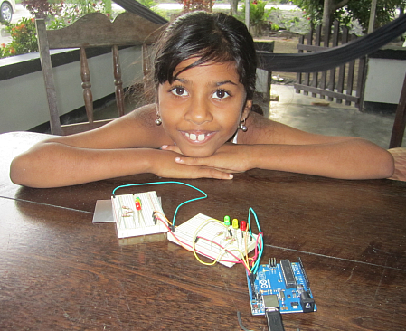
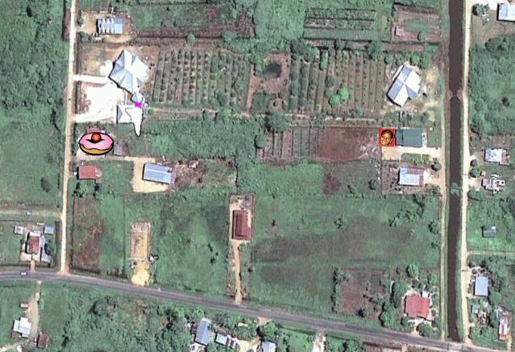
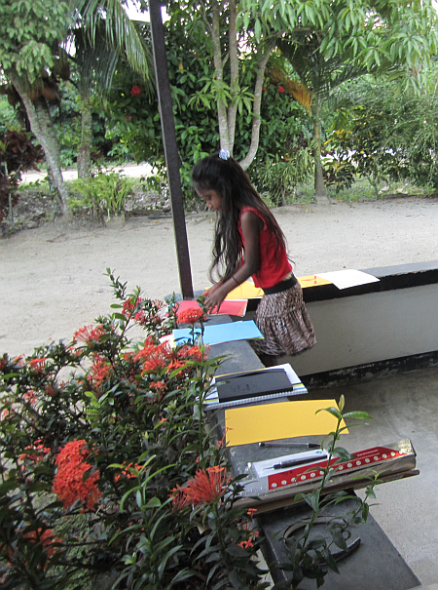
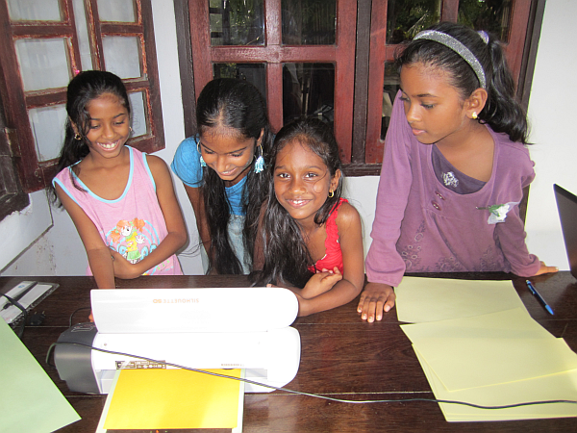
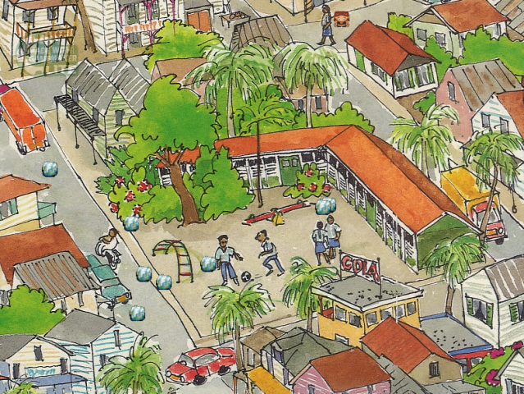
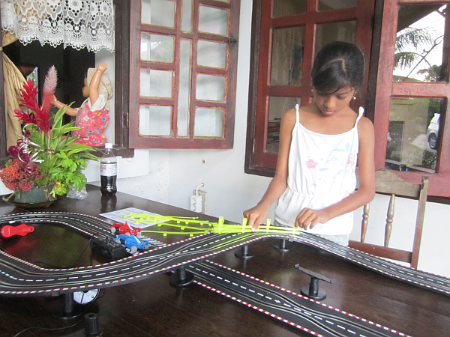
Mini fab lab

Slide 7
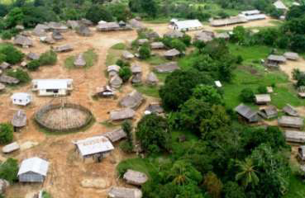
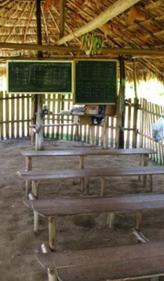
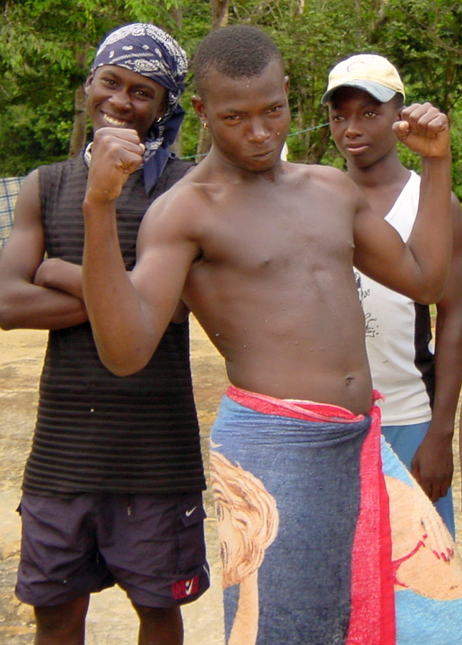
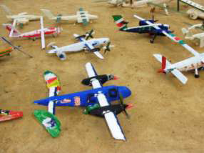
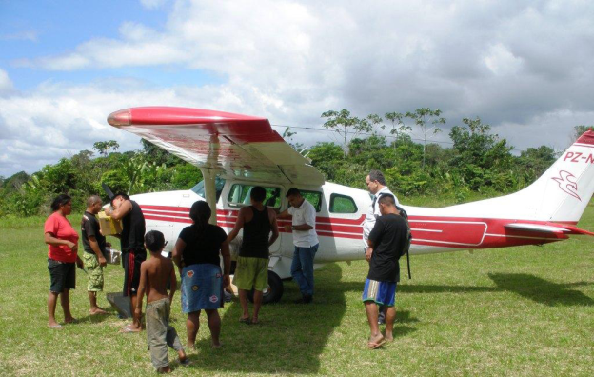
Jungle area
far from city – boat/plane traffic - schools primitive – gsm upcoming – self-sustaining – mining - indigenous people and “marrons” – migration to city
Source: 3 pictures to the left: IGSR

Slide 8
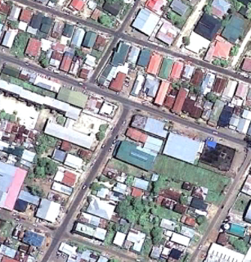
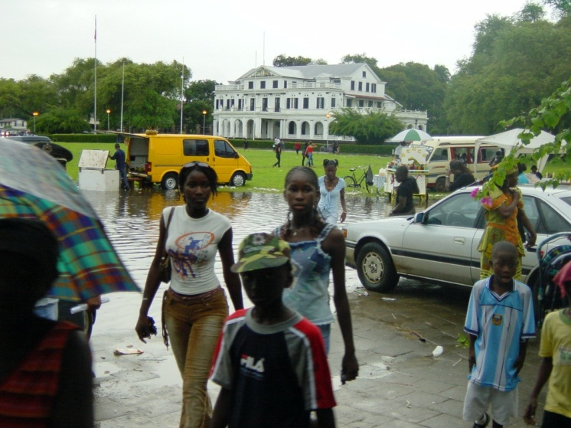
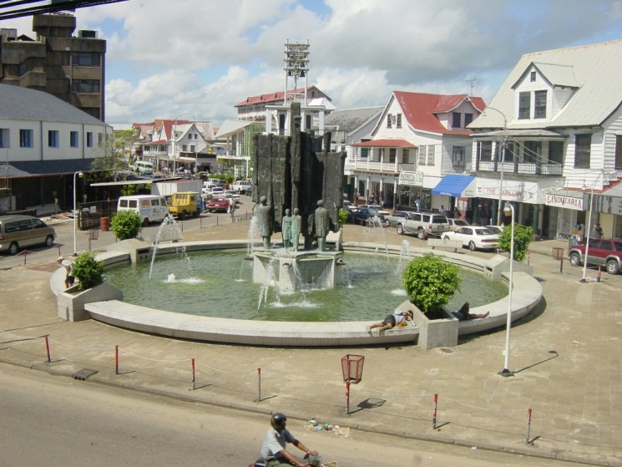
Urban area
City – Lively, shops, offices, bars, schools, dynamic, spending, unemployment
Source: left: Google Earth

Slide 9
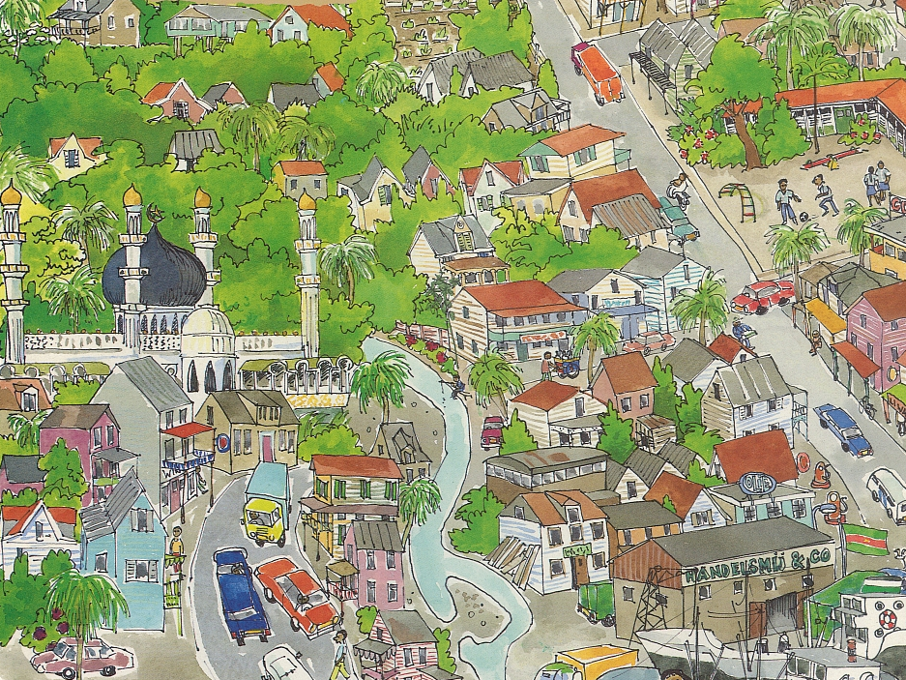
stakeholders
Creative campus
University
Research institutes
Internet provider
Techn. schools
Consultancies
Colleges
Ministry of education
Women movement
Embassy
Training centre
Adult education
Labour union
Govern-ment
NGO
Crafters
Bank
Employers ass.
Min. of labour & techn.
Min. of trade and industry
Big company
Chamber of commerce
Cultural centre
Museum
Waag society
Supra nationals
Drawing by A. Fienieg - 1992

Slide 10
Need for fab lab
Empower adults without education
Give all children access to up-to-date education
Develop community to fulfill its basic needs (electricity, clean water, sanitary conditions, repair)
Stimulate new businesses
Support small and medium enterprises to innovate
Connect to the world
Invention
Job Creation
Problem Solving
Education
Empowerment
The tower to empower (CSIR South Africa)

Slide 11
Stakeholders dynamics
Subsequent initiators
Fab Lab Waag Society
Local internet provider
Mixed creative campus initiative
Chamber of Commerce and Industry
Ministry of Technology
Government
Recurring pattern
Initial interest and claim of ownerschip
Limited follow-up actions
Competing priorities
Our policy
Who is the client?
Which help is required and appreciated?

Slide 12
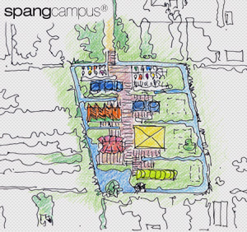
Regular fab lab
Mixed creative campus consortium (NL-SR)
Mixed motives (social, economical)
Fab Lab Waag Society involved
Long term perspective
Raising money for campus
Developing campus
Developing Fab Lab
Source: Spang Campus

Slide 13
Official fab lab
Government initiated
Mixed motives (boosting high tech, connecting to the world)
Contacts with various NL Fab Labs
Short term perspective
Funding available
Space available
People available

Slide 14
conclusion
Mini Fab Lab
Autonomous and flexible
Experiences in local context
Resources for spreading the word
Regular Fab Lab and Official Fab Lab
Stay in touch
Search for synergy
Help where possible

Slide 15
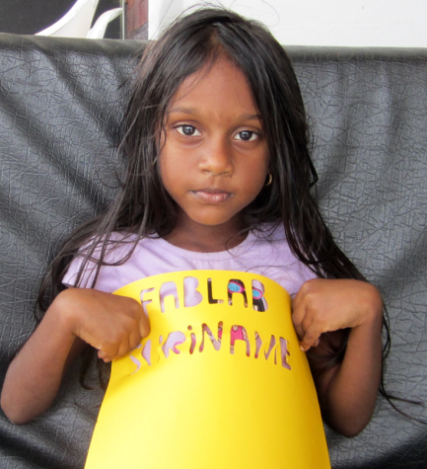
Kon hesi baka! – Come Back soon!
Thank You!
Pieter van der Hijden MSc ict for development, government, and learning Sofos Consultancy, The Netherlands www.sofos.nl – pvdh@sofos.nl

